Slide 1

Feature-Based Used Car Price Predictor Using Linear Regression and Support Vector Machines
By Parker Smith

Slide 2
Outline
Introduction and Motivation: What is the problem and why am I solving it?
Description and Details: A general description of the problem, the solution, and the results.
Extensive Results: A display of the results from this project including
How I gathered data
The performed tests
My key results
Conclusions and Future Work: What do these results show and how can this project be extended in the future?

Slide 3
Introduction and Motivation
Purchasing a car is the second largest purchase most people make.
Since the average price of a new car is $46,426 and the average price of a used car is $30,000, a large portion of the population has turned to purchasing used cars [1].
However, determining whether a listed price is fair and accurate is a more difficult task.
In the past, a consumer, car salesman, or private car seller would have to manually search through other car listings and (with their bias included), determine whether the price listed was accurate. This leads to inaccurate and time-consuming results.
This problem can be greatly simplified through machine learning.

Slide 4
Project Description
This project’s intent was to create a model that allowed any user to quickly determine an accurate price for a used car based on the car’s features.
This is useful for three parties: consumers, car salesmen, and private car sellers.
Consumers can purchase a car without the manual searching, saving time and money.
Car salesmen can determine a price where they can sell their car with a high enough margin for profit, but a low enough price to attract consumers.
Private car sellers often have an overinflated sense of how much their car is worth [2]. This model would allow those users to see a more accurate price of their car and become more competitive on the market.

Slide 5
Project Description (cont.)
This project is based off CS 229 Project Report: Predicting Used Car Prices by Kshitij Kumbar, Pranav Gadre, and Varun Naya [3].
While the dataset for the baseline is huge, 1.2 million listings, the number of features is very minimal, only six. After preprocessing, only 5 of those features are used for their models. This was much too small for an accurate result.
Multiple models were used in the baseline: Linear Regression, Random Forest, Gradient Boost, XGBoost, LightGBM, KMeans + Linear Regression, and a Neural Network.
Unfortunately, all of these models took a very long time to train, and produced accuracy ratings that were below 90%.

Slide 6
Project Details
This project was partially built on the baseline with the intent of improving the training time and the accuracy rating.
Therefore, this project simply uses two models: a Support Vector Machine (SVM) and Multiple Linear Regression.
The dataset for this project comes from Kaggle and includes 560,000 car listings [4].
This project runs the dataset through each model a single time and returns the R² Accuracy, the Mean Squared Error (MSE), the Root Mean Squared Error (RMSE), and the time it took to train the model.
My initial models showed great success, with both taking less than a minute to train and having an R² accuracy of over 90%.

Slide 7
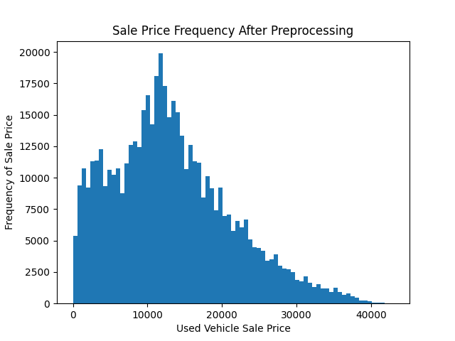
Extensive Results – The Dataset
The dataset chosen for this project from Kaggle included 4 continuous factors and 12 categorical factors, the most important include the vehicle’s year, make, body style, transmission, condition, odometer reading, and selling price.
Once the dataset was selected, I had to preprocess the data to remove outliers and clean up unnecessary factors.

Slide 8
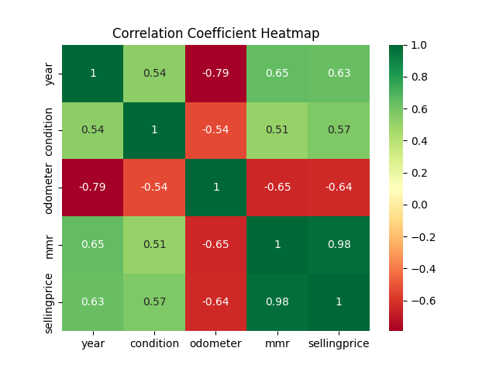
Extensive Results – The Dataset
After preprocessing the data, the categorical features were encoded using the OneHotEncoding scheme. This translates categories into binary features and overall adds more features to the dataset.
Finally, before testing, I determined the linearity of the dataset’s features by comparing several of the continuous features to the sale price.

Slide 9
Performed Tests – Linear Regression
The first model I chose, due to the high linearity of the data, was a Multiple Linear Regression model.
Using 4 continuous features and 8 categorical features, the Linear Regression model ran with a 90% training and 10% testing split on a single epoch.
The accuracy of the model is measured using R² accuracy, MSE, RMSE, and training time.

Slide 10
Performed Tests – SVM
The second model I chose, due to its heavy use in machine learning, was a linear SVM model.
This model also used 4 continuous features and 8 categorical features like the Linear Regression model. It ran with a 90% training and 10% testing split.
The SVM model used a linear kernel to emulate linear regression, and the tolerance value for the SVM was set to be .075.
Finally, before any data was inputted to the SVM, it had to be standardized to be between -1 and 1.
The accuracy of the model is measured using R² accuracy, MSE, RMSE, and training time.

Slide 11
Results
Both models ultimately had remarkably similar results: around 97% accuracy, 1,450 RMSE, and a training time of less than a minute.
The RMSE is an important result factor as it has the same unit as the dependent variable (in this case, the selling price). Therefore, this shows that both models will have a + or - $1,450 error when it estimates a car’s value.
 | Linear Regression | SVM
R² Test Accuracy | 96.84% | 96.74%
R² Training Accuracy | 96.84% | 96.72%
MSE Loss | 2,022,285 | 2,097,970
RMSE Loss | 1,422.07 | 1,448.44
Training Time | 44 Seconds | 38 Seconds

Slide 12
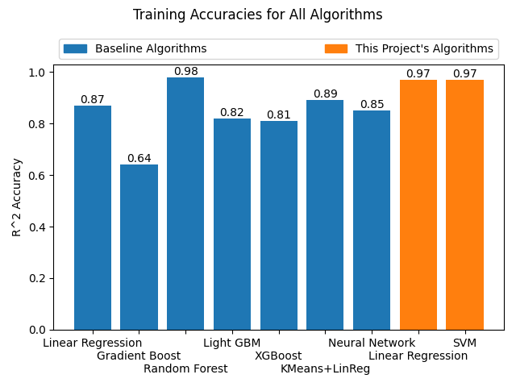
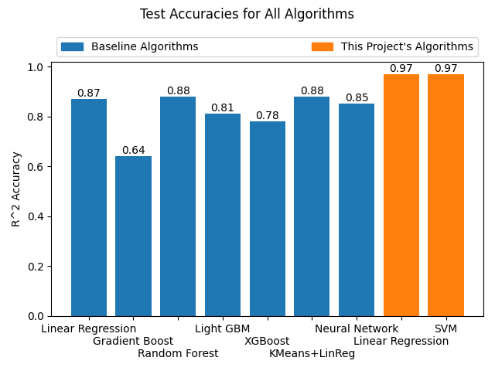
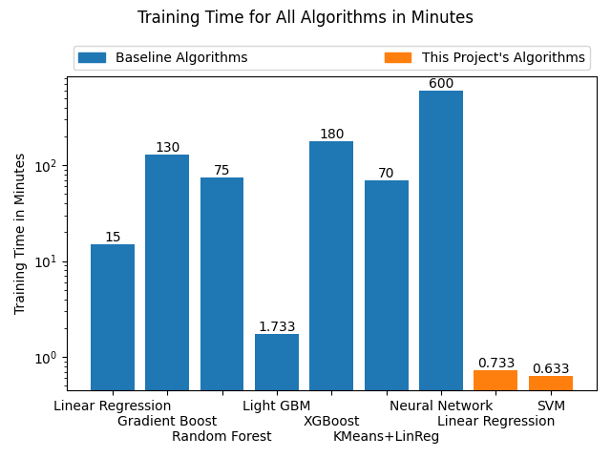
Results (cont.)
Ultimately, this project’s two models performed significantly better than the baseline’s models when compared.

Slide 13
Conclusion
This project shows that is completely possible to determine the price of a used car given its features. The results are even very accurate and could be used in a commercial setting.
Whether the Linear Regression or SVM model is chosen, both take a short time to train and provide a similar result, a critical aspect in today’s fast-moving world.
Certainly, any user, whether it be a consumer, used car salesman, or private seller, can use this project’s findings to determine the price of their car rapidly and with a high degree of confidence.

Slide 14
Future Work
Dataset with more recent car listings (possibly with more features)
Use an internet API to find accident claims based on the vehicle’s VIN number
For the SVM model, further optimize the hyperparameters and possibly improve the kernel
Front-end GUI to enter some features and get a quick result

Slide 15
Works Cited
[1] C. Isidore, “Why car prices remain so stubbornly high,” CNN Business, 2022. [Online]. Available: https://www.cnn.com/2022/01/20/business/car-prices-easing-2022/index.html
[2] J. M. Vincent, “Buying a car from a private seller,” U.S. News & World Report, 2020. [Online]. Available: https://cars.usnews.com/cars-trucks/buying-a-car-from-a-private-seller-
[3] K. Kumbar, P. Gadre, and V. Nayak, “Cs 229 project report: Predicting used car prices,” December 2019. [Online]. Available: https://cs229.stanford.edu/proj2019aut/data/assignment_308832_raw/26612934.pdf
[4] B. Tunguz, “Used car auction prices,” 2015. [Online]. Available: https://www.kaggle.com/tunguz/used-car-auction-prices

